Slide 1


Passenger Flow Tracking
Anomaly Detection | Smart Surveillance
July 2023

Slide 2





Meet the team
Said Khaled Said Ashour
Anas Ahmed Mohamed
Gamal Ahmed AbdElhakm
Mahmoud Ali Mahmoud
Mohamed Zien El Abdeen

Slide 3
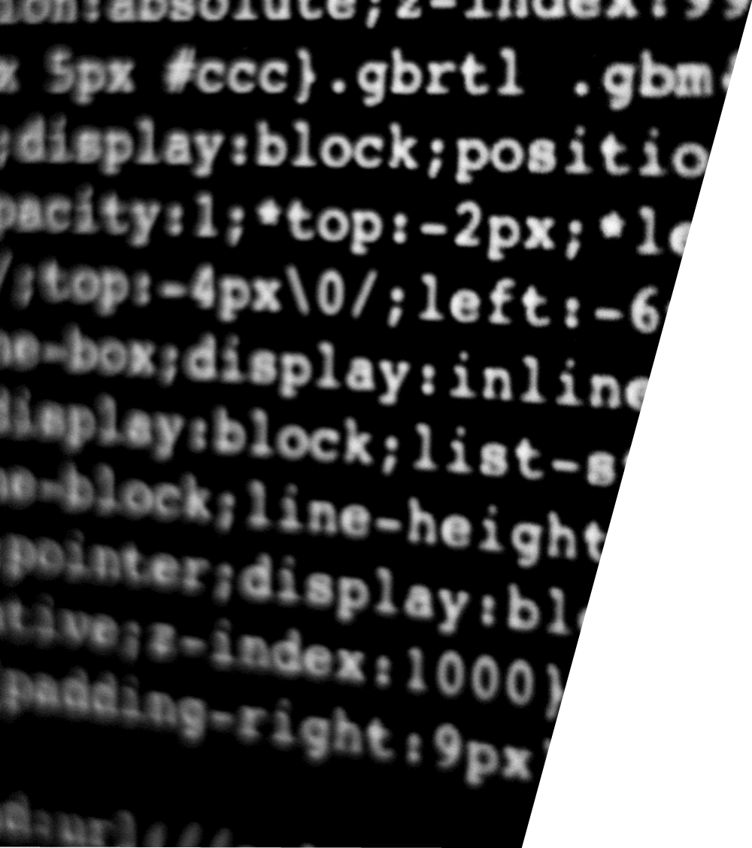
Agenda
Recap
What was our problem?
How did we approach the problem?
Why?
Work
Recap
Result Demonstration
Architecture
Analysis
Future work

Slide 4
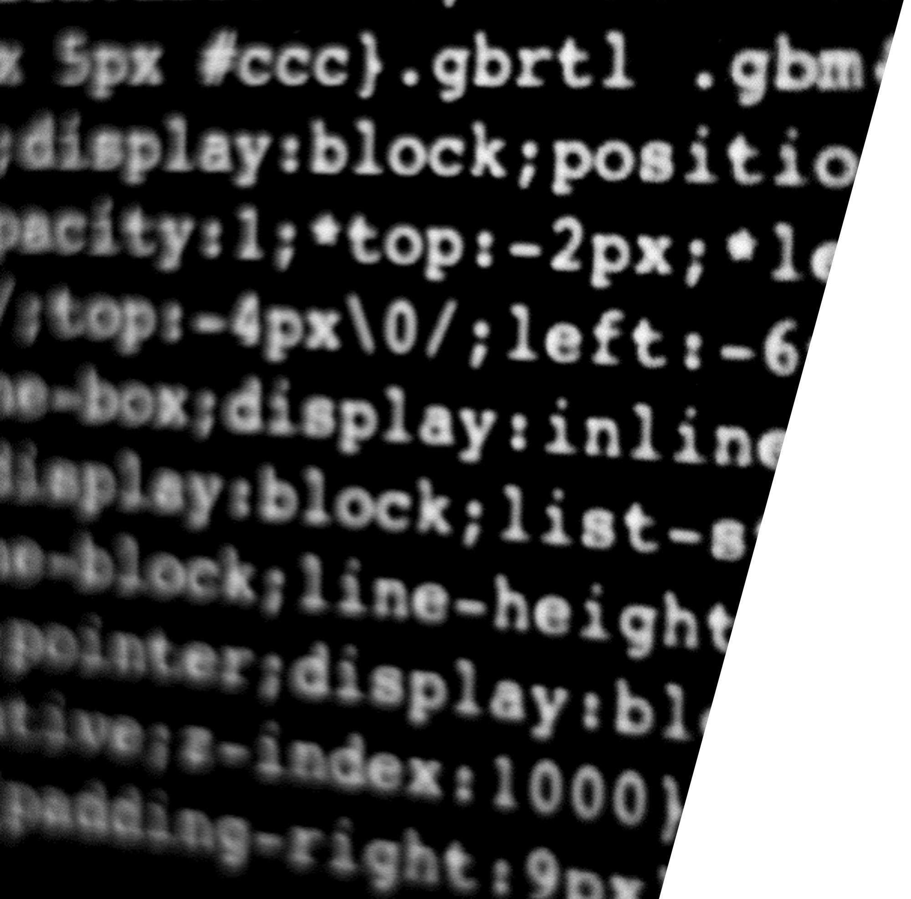
Recap
What was our problem?
How did we approach the problem?
Why?
Work

Slide 5


What Was our Problem?
Smart Surveillance
Having one or multiple individuals detect anomalies or accidents, and monitoring passengers is challenging, inefficient and time consuming.

Slide 6
The Approach

Slide 7
Why Weakly Supervised Learning?

Slide 8

Models
(Extraction / Prediction)
Datasets
Result Demonstration
Dataset: ShanghaiTech
Feature Extraction: Inflated 3D ConvNet
Prediction: Robust Temporal Feature Magnitude Learning (RTFM)

Slide 9
Result Demonstration

Slide 10
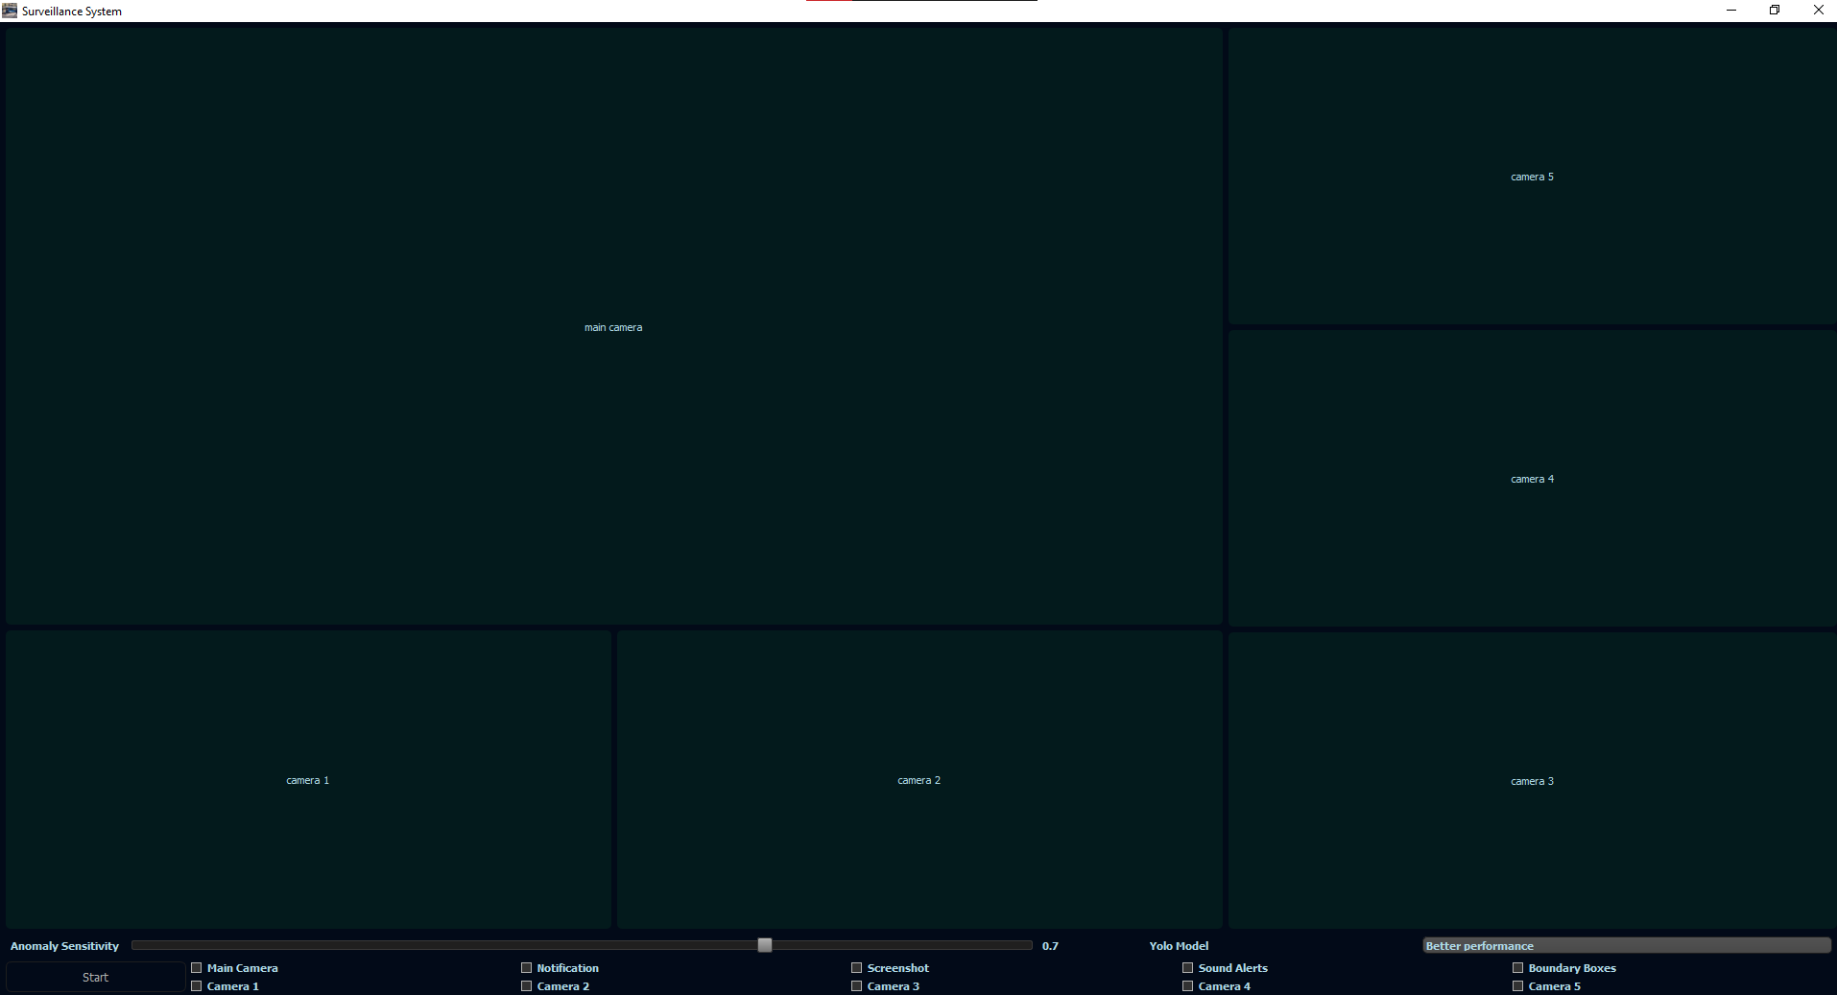
Initial State

Slide 11
Toolbar

Slide 12
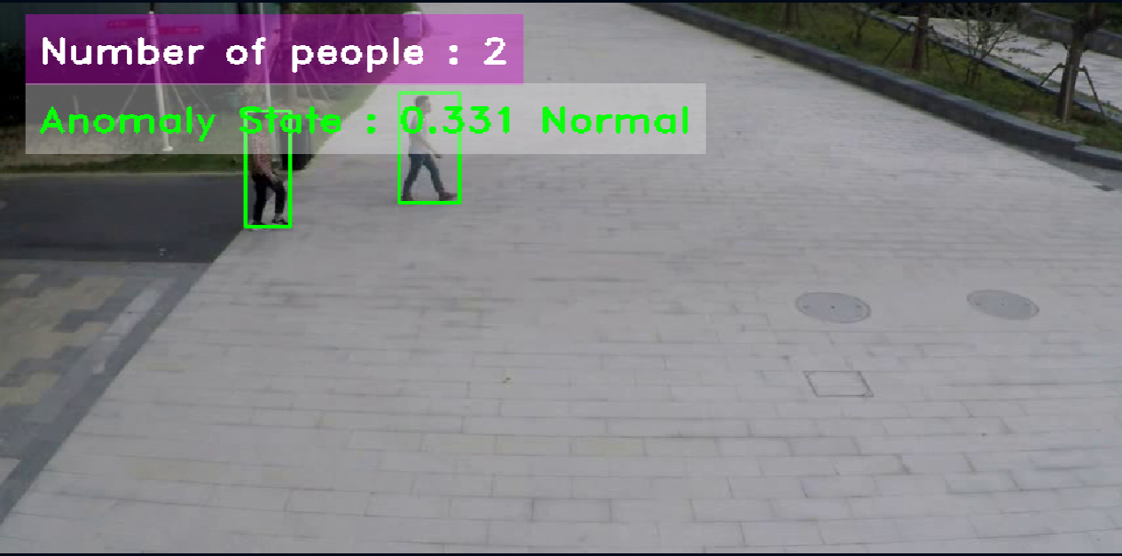
Normal State

Slide 13
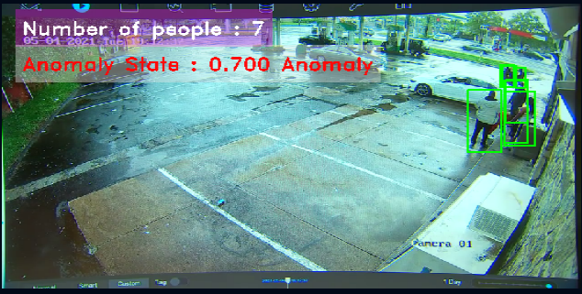
Anomaly State

Slide 14
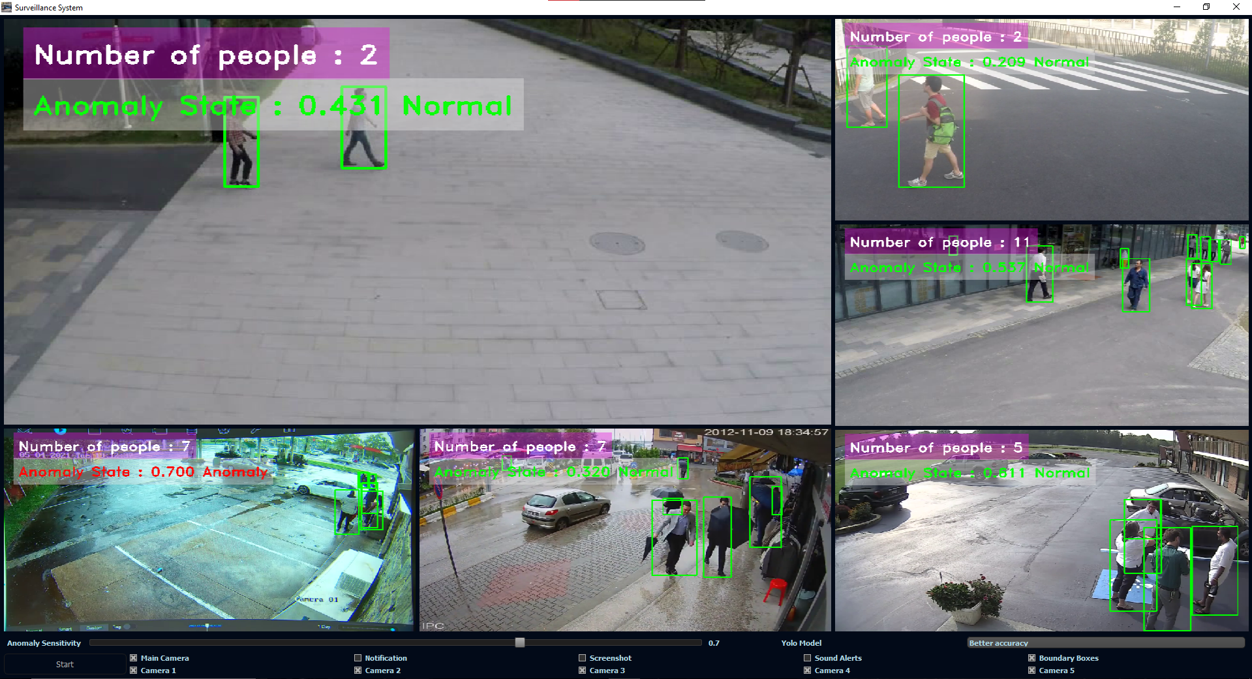
Full Program Running

Slide 15
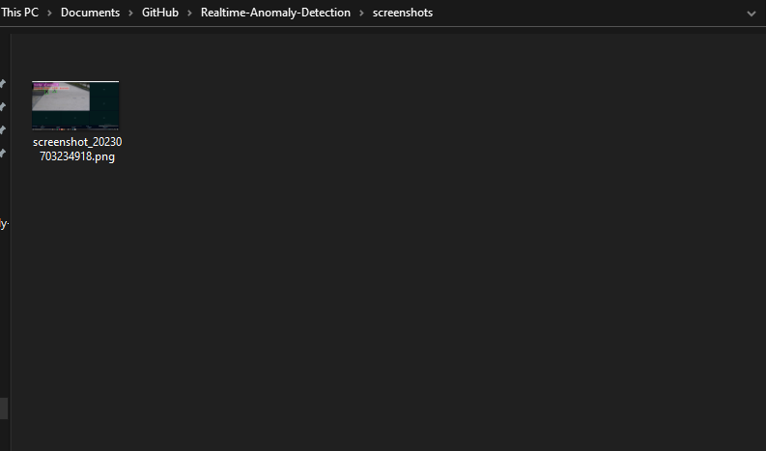
Screenshot of The Anomaly is Saved in a Folder

Slide 16
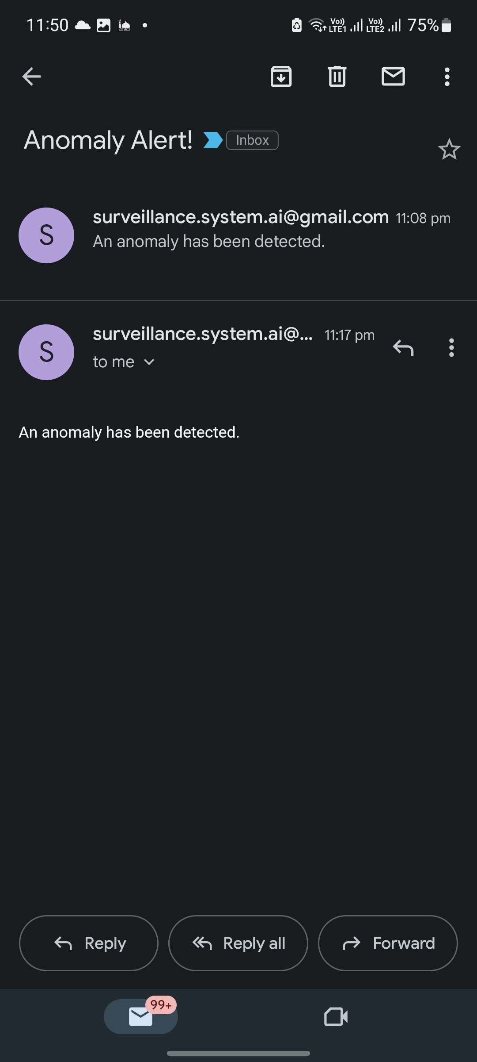
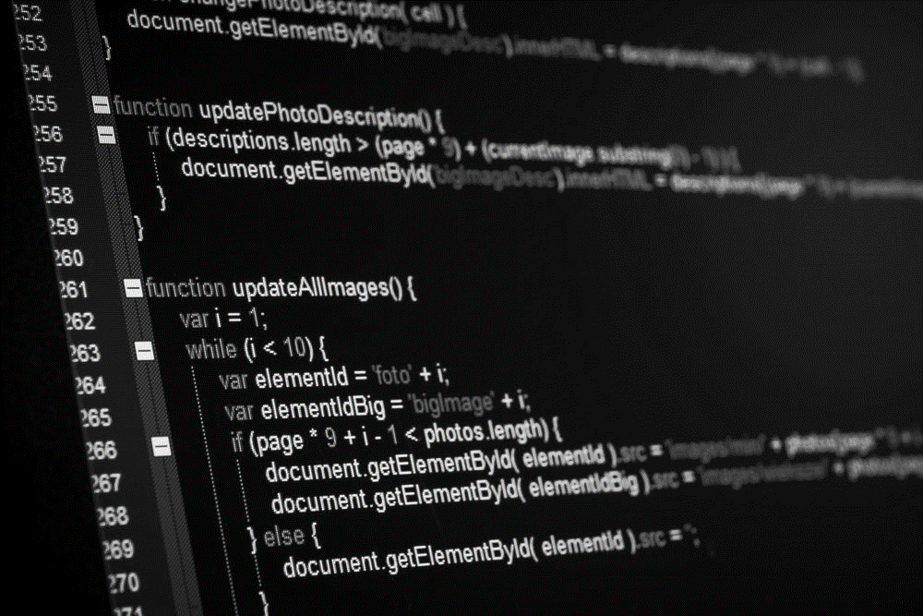
Notification is Sent via Email
Architecture

Slide 17
Architecture

Slide 18
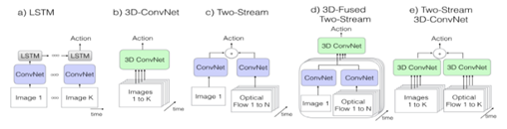
Feature Extraction with I3D Model

Slide 19
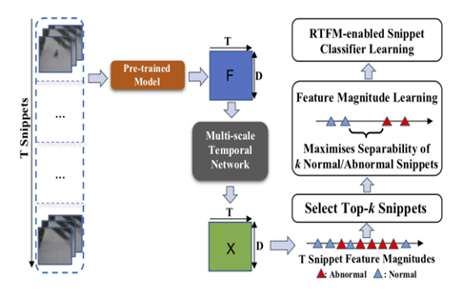
Anomaly Prediction with Robust Temporal Feature Magnitude Learning (RTFM) Model

Slide 20
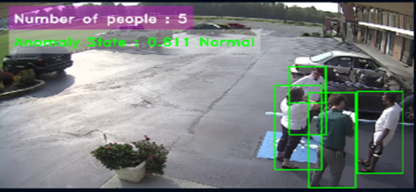
Object Detection with YOLOv8 Model

Slide 21
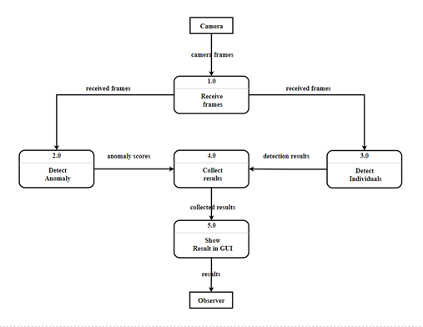
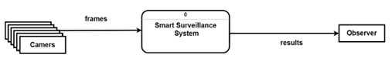
Data Flow Diagram
DFD context level
DFD level 0

Slide 22
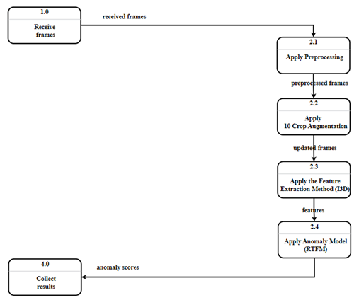
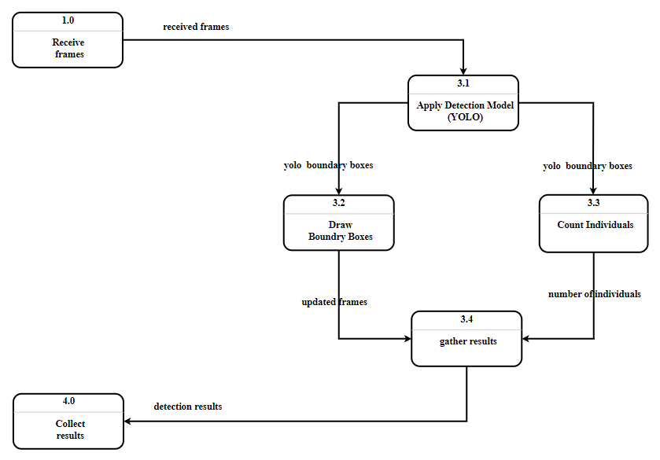

Data Flow Diagram
Analysis
DFD level 1: YOLO
DFD level 1: RTFM

Slide 23
Analysis

Slide 24
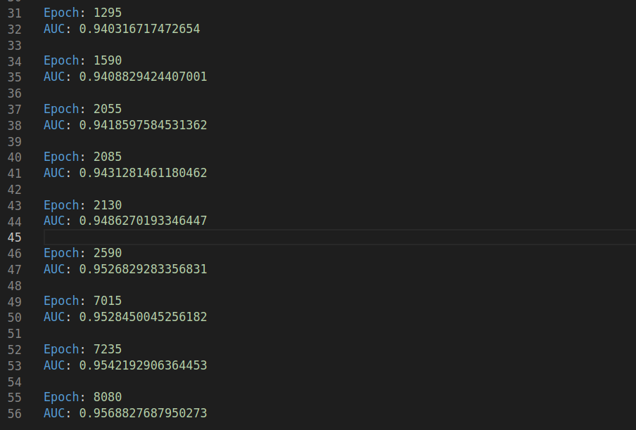
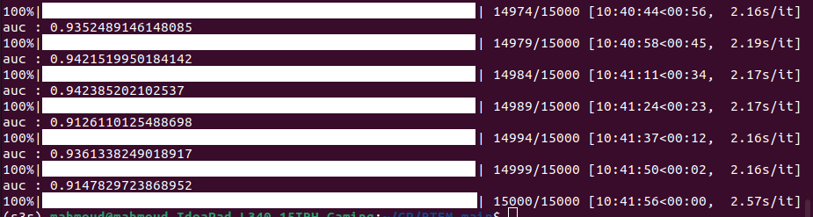
Training Results

Slide 25

Performance
Dataset
Anomaly Prediction
Feature Extraction
Object Detection

Slide 26
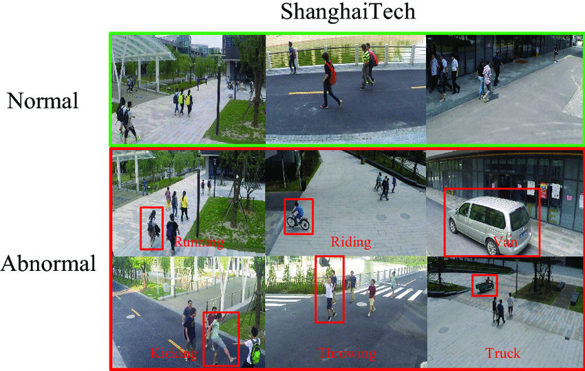
Dataset

Slide 27
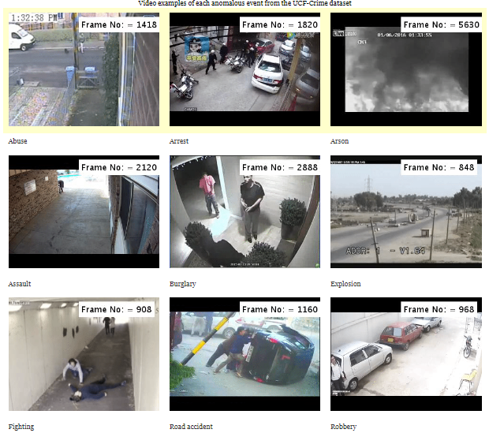
Dataset

Slide 28
Performance
Dataset
Anomaly Prediction
Feature Extraction
Object Detection

Slide 29
Anomaly Prediction
RTFM
MGFN

Slide 30
Performance
Dataset
Anomaly Prediction
Feature Extraction
Object Detection

Slide 31
Feature Extraction
I3D
Video-Swin

Slide 32
Performance
Dataset
Anomaly Prediction
Feature Extraction
Object Detection

Slide 33
Object Detection
Better Accuracy
Better Performance

Slide 34
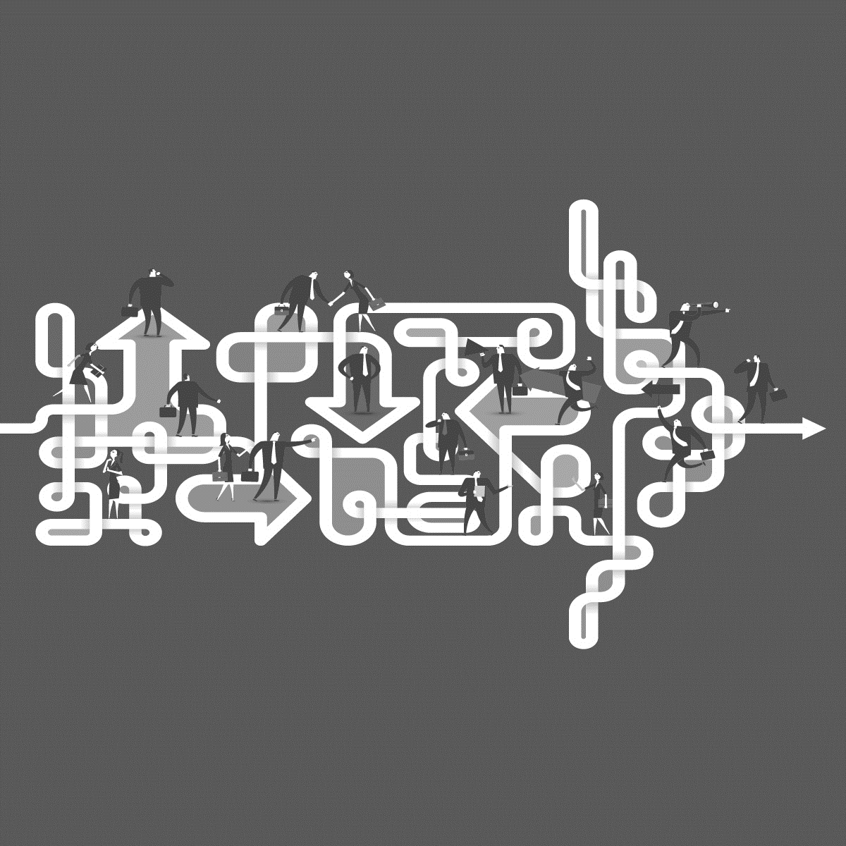
Performance
Future work
Dataset
Anomaly Prediction
Feature Extraction
Object Detection

Slide 35
Future work

Slide 36
Future Work
Graphical User Interface (GUI) Enhancements
Cloud Integration and Remote Monitoring
User Authentication and Access Control
Performance Optimization

Slide 37

Thank You
Questions?
July 2023

